Slide 1
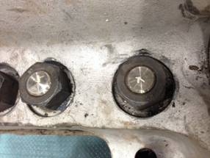
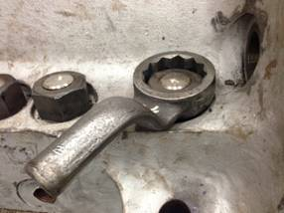
HS&E INCIDENT BULLETIN |  | 1st half year 2014
U.S. | Type of incident - Strain
Summary:
Employee experienced a sore lower lumbar following extended effort to remove split stud nuts from a legacy case. The legacy case design prevented adequate clearance of the tools used. This, coupled with the snugness of the nuts caused by numerous high temperature tests, resulted in excessive force to remove the nuts.
Root Causes: | Actions Taken Thus Far: Next Steps
Inadequate technical design. | Replace existing nuts with “super nuts”, procure better fitting wrench

